Slide 1
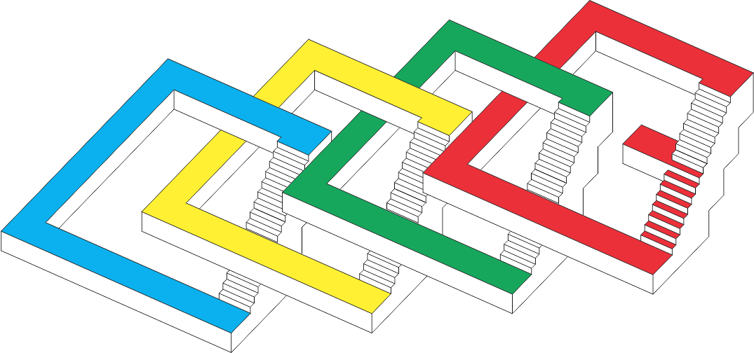
Variable Radii Poisson-Disk Sampling
Scott A. Mitchell, Alexander Rand, Mohamed S. Ebeida, Chandrajit Bajaj
www.cs.sandia.gov/~samitch
(or Google Mitchell Sandia)
24th Canadian Conference on Computational Geometry
8-10 August 2012
Session 4B
Thursday Aug 9
11:30-11:50

Slide 2
Goal – convince you
There is still interesting Computational Geometry work for generating separate-yet-dense point sets
Delaunay Refinement (DR) doesn’t solve everything
Poisson-disk output has some advantages
Graphics cares
Fracture mechanics cares
Even though slower than deterministic DR
Slightly different than sphere packings

Slide 3
Outline
Maximal Poisson-Disk Sampling (MPS) – what is it, why do we care
Graphics apps
Simulations
Our prior results for MPS points, Voronoi and Delaunay meshes
Sites may encroach on boundary, not dual of a body-fitted tetrahedralization
Spatially varying radii
Lipschitz conditions
Motivation: MPS spectrum vs. blue noise
Two-radii MPS definition
Random refinements
MPS output vs. Delaunay Refinement (DR)
PSA Spectrum
Angle spectra vs. DR, Edge length vs. DR

Slide 4
Maximal Poisson-Disk Sampling
What is MPS?
Dart-throwing
Insert random points into a domain, build set X
With the “Poisson” process
Ω
x₄?

Slide 5
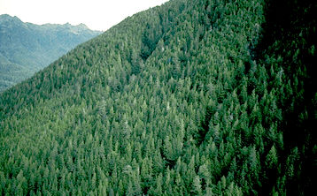
MPS a.k.a.
Statistical processes
Hard-core Strauss disc processes
Non-overlap: inhibition distance r₁
cover domain: disc radius r₂
Geostatistics focus is inverse problem
Given satellite pictures (non-maximal dist.)
How many trees are there?
How much lumber?
Trees in a forest
Points are trunks
Disks are canopy or
separation distance
Random sphere packing
r/2-disks non-overlap
MPS = random sequential adsorption
(atoms in a liquid, crystal)
New Mexico “Forest”
r₁>r₂
British Columbia Forest r₁<r₂

Slide 6
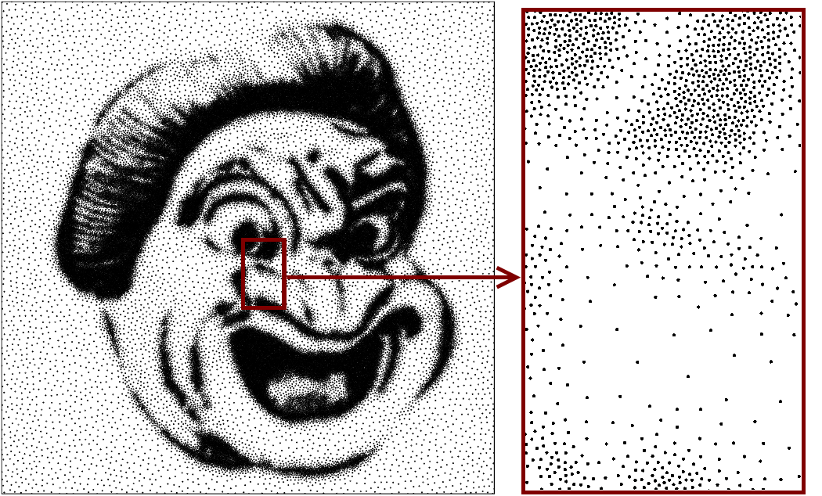
Motivation from old-school Static Graphics
Stippling: images from dots, as newsprint (results from this paper)

Slide 7
Motivating from Modern Graphics: (Brush) Stroke-Based Rendering
CG artistic effect to mimic physical media
Images from Aaron Hertzmann, Stroke-Based Rendering

Slide 8
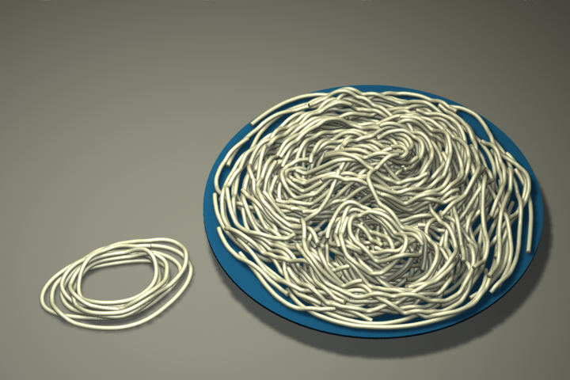
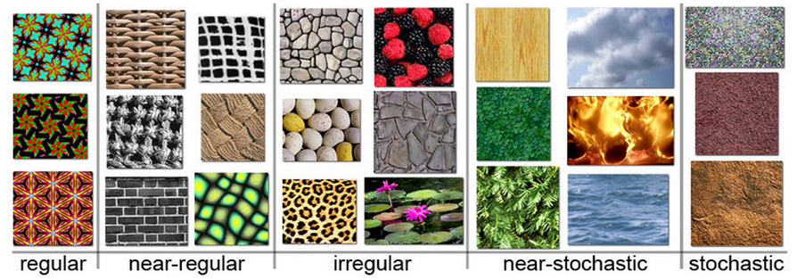
Motivating from Modern Graphics: Texture Synthesis
Real-time environment exploration. Games! Movies!
Algorithm to create output image from input sample
Arbitrary size
Similar to input
No visible seams, blocks
No visible, regular repeated patterns examples from wikipedia:
Spaghetti Li Yi Wei
SIGGRAPH 2011

Slide 9
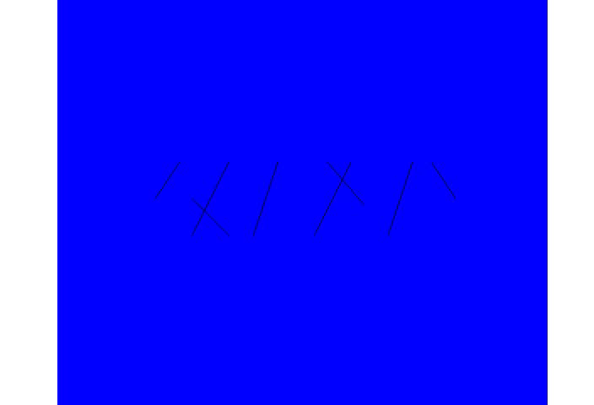
What is MPS good for? Sandia cares about Games and Movies? training…
Physics simulations – why SNL paid for year 1-2 ☺
Voronoi mesh, cell = points closest to a sample
Fractures occur on Voronoi cell boundaries
Mesh variation material strength variation
CVT, regular lattices give unrealistic cracks
Unbiased sampling gives realistic cracks
Ensembles of simulations
Domains: non-convex, internal boundaries
Fracture Simulations
Courtesy of Joe Bishop (SNL)
95%
80%
Seismic Simulations
maximal helps Δ quality

Slide 10
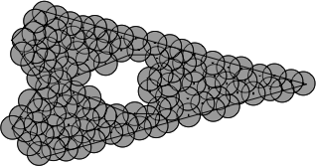
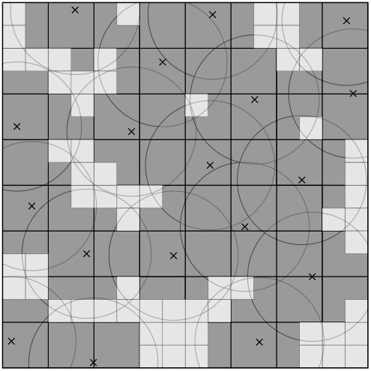
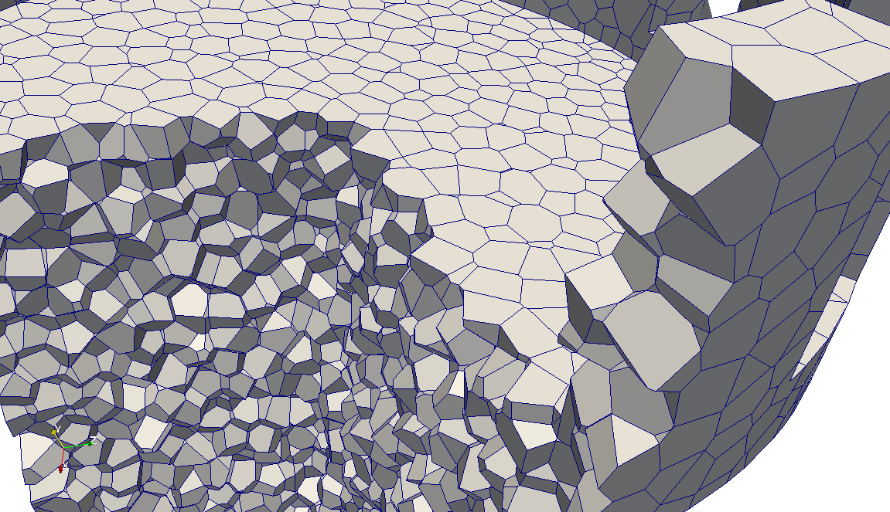
Prior Results
Many fast Graphics algorithms that modified the process slightly, or the termination criteria
First E( n log n) algorithm with provably correct output
Efficient Maximal Poisson-Disk Sampling, Ebeida, Patney, Mitchell, Davidson, Knupp, Owens, SIGGRAPH 2011
Simpler, less memory, provably correct, faster in practice but no run-time proof
A Simple Algorithm for Maximal Poison-Disk Sampling in High Dimensions, Ebeida, Mitchell, Patney, Davidson, Owens Eurographics 2012
Voronoi Meshes
Sites interior, close to domain boundary are OK, not the dual of a body-fitted Delaunay Mesh
Uniform Random Voronoi Meshes Ebeida, Mitchell IMR 2011
Delaunay Meshes
Protect boundary with random balls
Efficient and Good Delaunay Meshes from Random Points Ebeida, Mitchell, Davidson, Patney, Knupp, Owens SIAM GD/SPM 2011

Slide 11
First Contribution
Uniform, static literature pretty rigorous
Graphics papers with heuristics for sampling curved surfaces, non-uniformly
unknown or unstated Lipschitz criteria, neighbor datastructures that sometimes blow-up in practice
Lipschitz conditions for spatially varying radii function
Reasons and proof techniques as in Delaunay Refinement

Slide 12
How fast can radii vary?
If varies slowly
bounded # neighbors for disk conflict checks <-> bounded-angle DT
If shrink too fast
Unbounded # neighbors
Infinite run-time
Zero angles in triangulation
α
Still big, OK
α
Vanishing radius, infinite neighbors

Slide 13
Q. How fast can it vary? A. Depends how Conflict is defined.
L is Lipschitz constant: f(x)-f(y) < L |x-y|
Four common methods in Graphics
new
new
old
old
Prior: new candidate disk center inside an old prior disk
Bigger: small disk center inside big disk center
Smaller: big disk center inside small disk center
new
new
Bigger is stricter than
Sphere packing:
½ radius disks overlap distance: sum(r(x),r(y))/2
old
old
Current: old prior disk center inside a new candidate disk

Slide 14
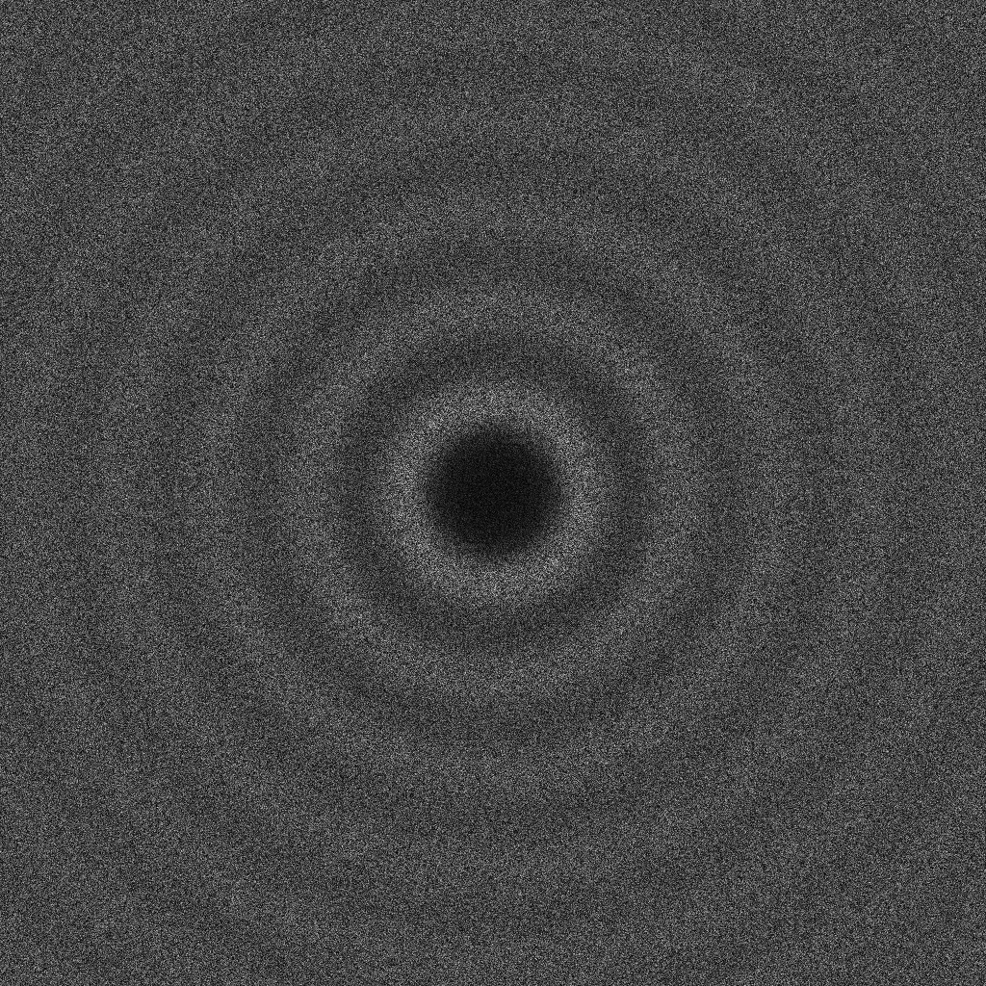
Graphics Quality Criteria
Average radial power of FFT
Point Cloud
FFT of all pairwise
distances
Point Set Analysis: http://code.google.com/p/psa/
OK, but what about these?
Graphics papers say they like MPS because
Small low frequency component
No big spikes, especially spikes at high frequency
IMO want truncated white-noise
Unknown: analytic description of the limit distribution for MPS, Mean location and magnitude, std deviations of peaks?
Anyone know some good spatial statisticians to work with?

Slide 15
Our Solution (second contribution)
Disk coverage radius larger than free radius
R_{c} > R_{f} (yellow > green)
New disks must cover some unique uncovered area
Else maximal (limit) distribution would be the same
Contrast to Hard-core Strauss disc process: coverage disks are observed, no effect on process
Process:
New candidate point uniform at random
(f) Rejected if center inside a small green disk
(c) Accepted if its yellow disk covers some white area
OK, covers some white
Alg:
Only generate points in an outer approximation to regions satisfying (c) and (f) in the first place.
reject, inside a green disk
reject, yellow already covered

Slide 16
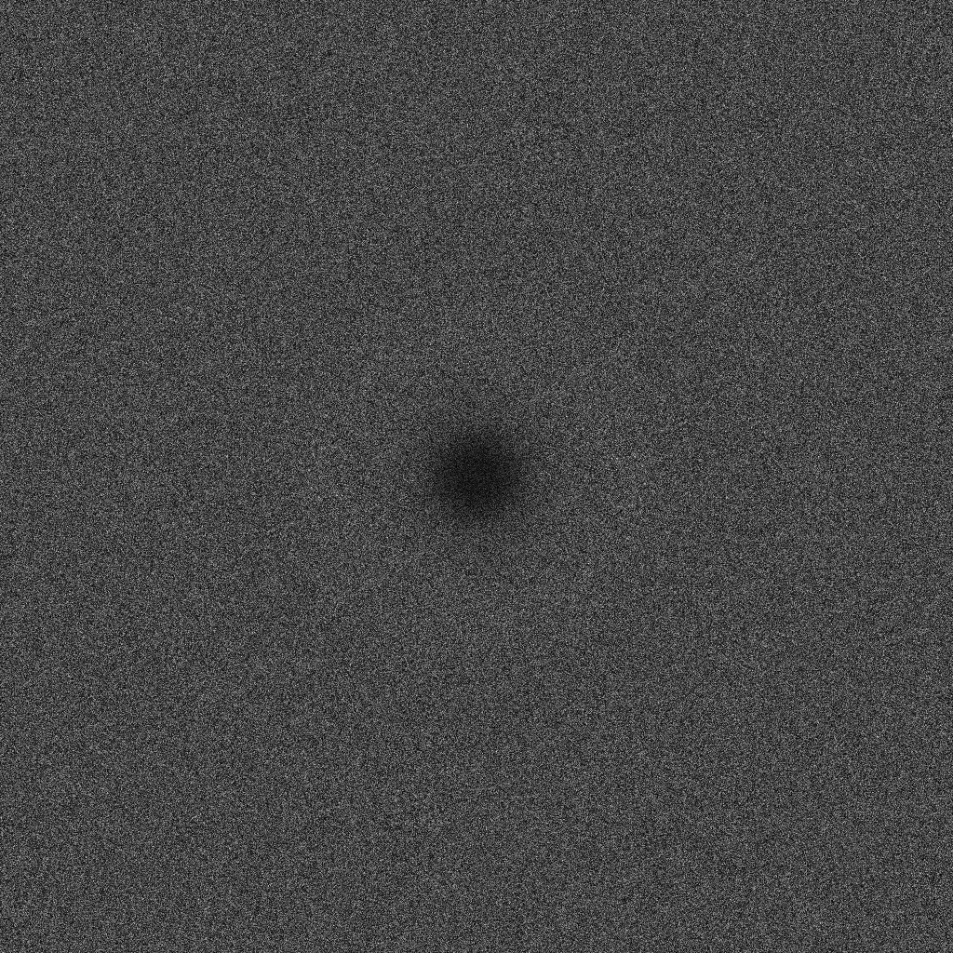

Two-radii MPS output
Classic MPS R_{f} = R_{c}
Two-radii MPS 2 R_{f} = R_{c}
R_{f} = min center dist
R_{c} =max Vor dist
Uniform R = 0 non-maximal

Slide 17
Random refinements by shrinking radius
Continuously shrink radii
Coverage radius (blue) larger than inhibition radius (red)
With one radius, get deterministic point placement,
at Voronoi vertex, as classic Delaunay Refinement
With two radii, random placement,
neighborhood of Voronoi vertex: inside green disk-at-u outside red

Slide 18
Hierarchical by shrinking radius
Discrete steps
Simple since continue original algorithm
No noticeable effect on output spectrum

Slide 19
Contrast to Delaunay Refinement (DR)
Direct sizing control
Disks centered at points, sized at that point
Never O(n²) – no intermediate triangulation, generate points first
No concentration at medial axis as DR
Global Random placement
Slow vs. local deterministic DR
Spectrum results for DR depends on target, queue order Alex Rand experiments in progress

Slide 20
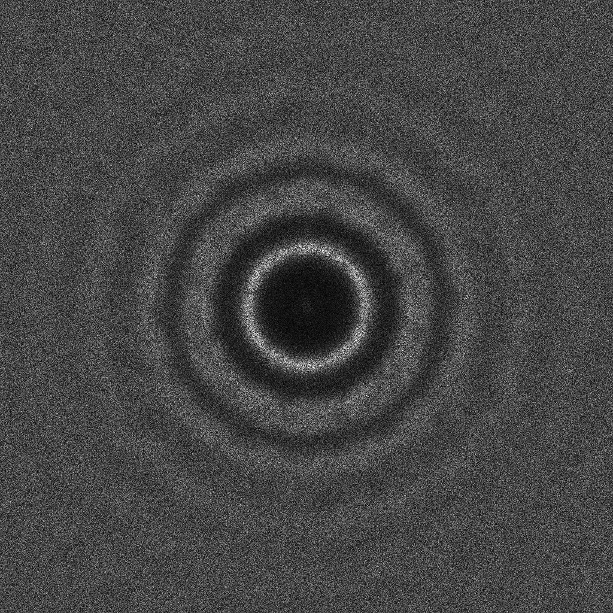
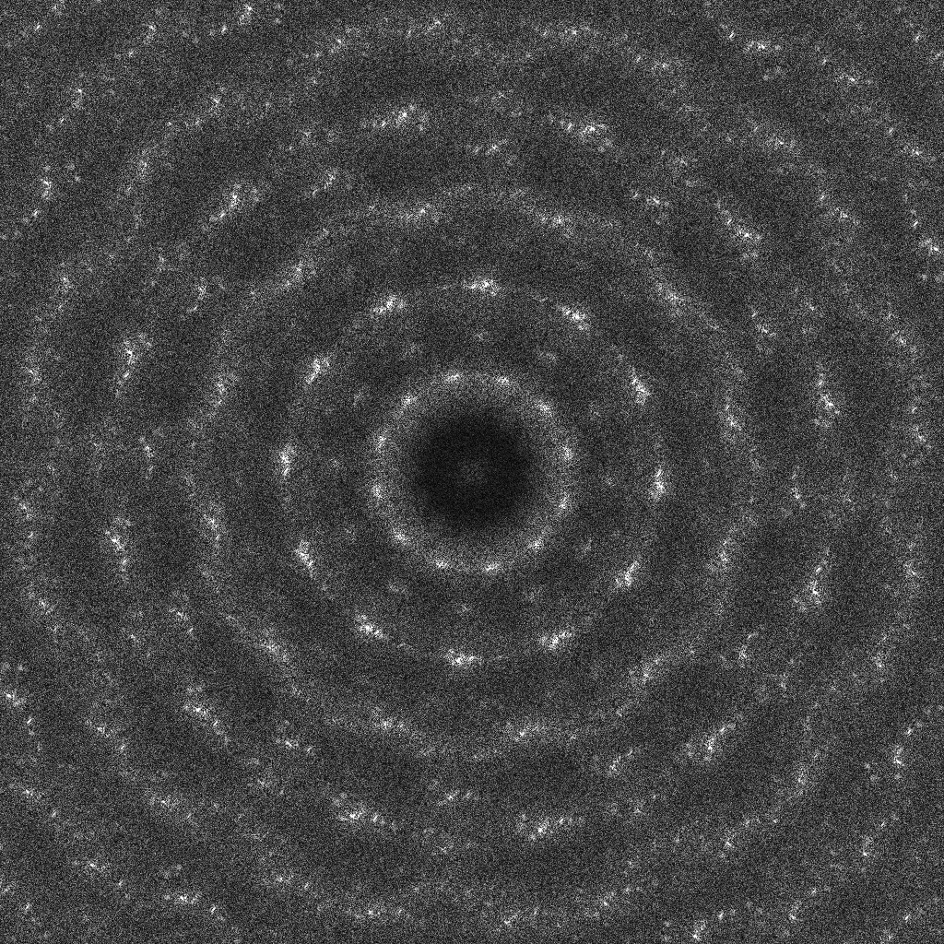
Spectrum results for DR
Depends on target, queue order (Alex Rand experiments in progress)

Slide 21
Uniform MPS vs. DR angles and edges
To do: study and contrast further

Slide 22
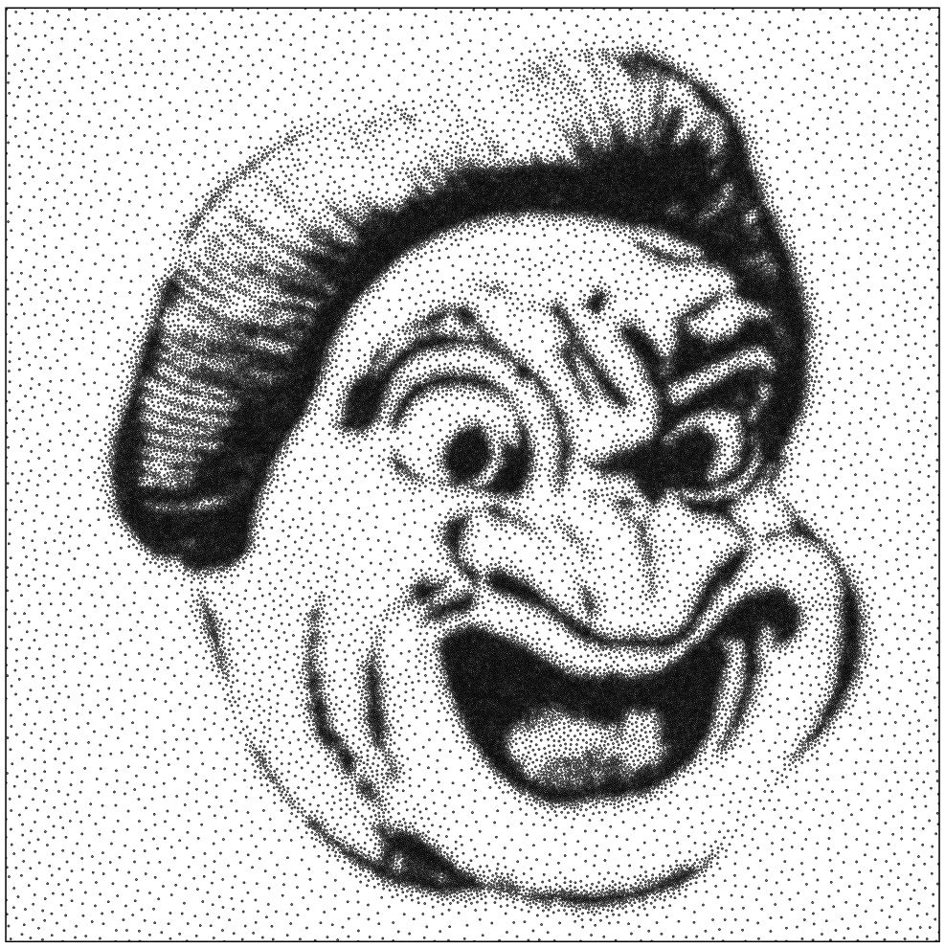
Thanks!

